Slide 1
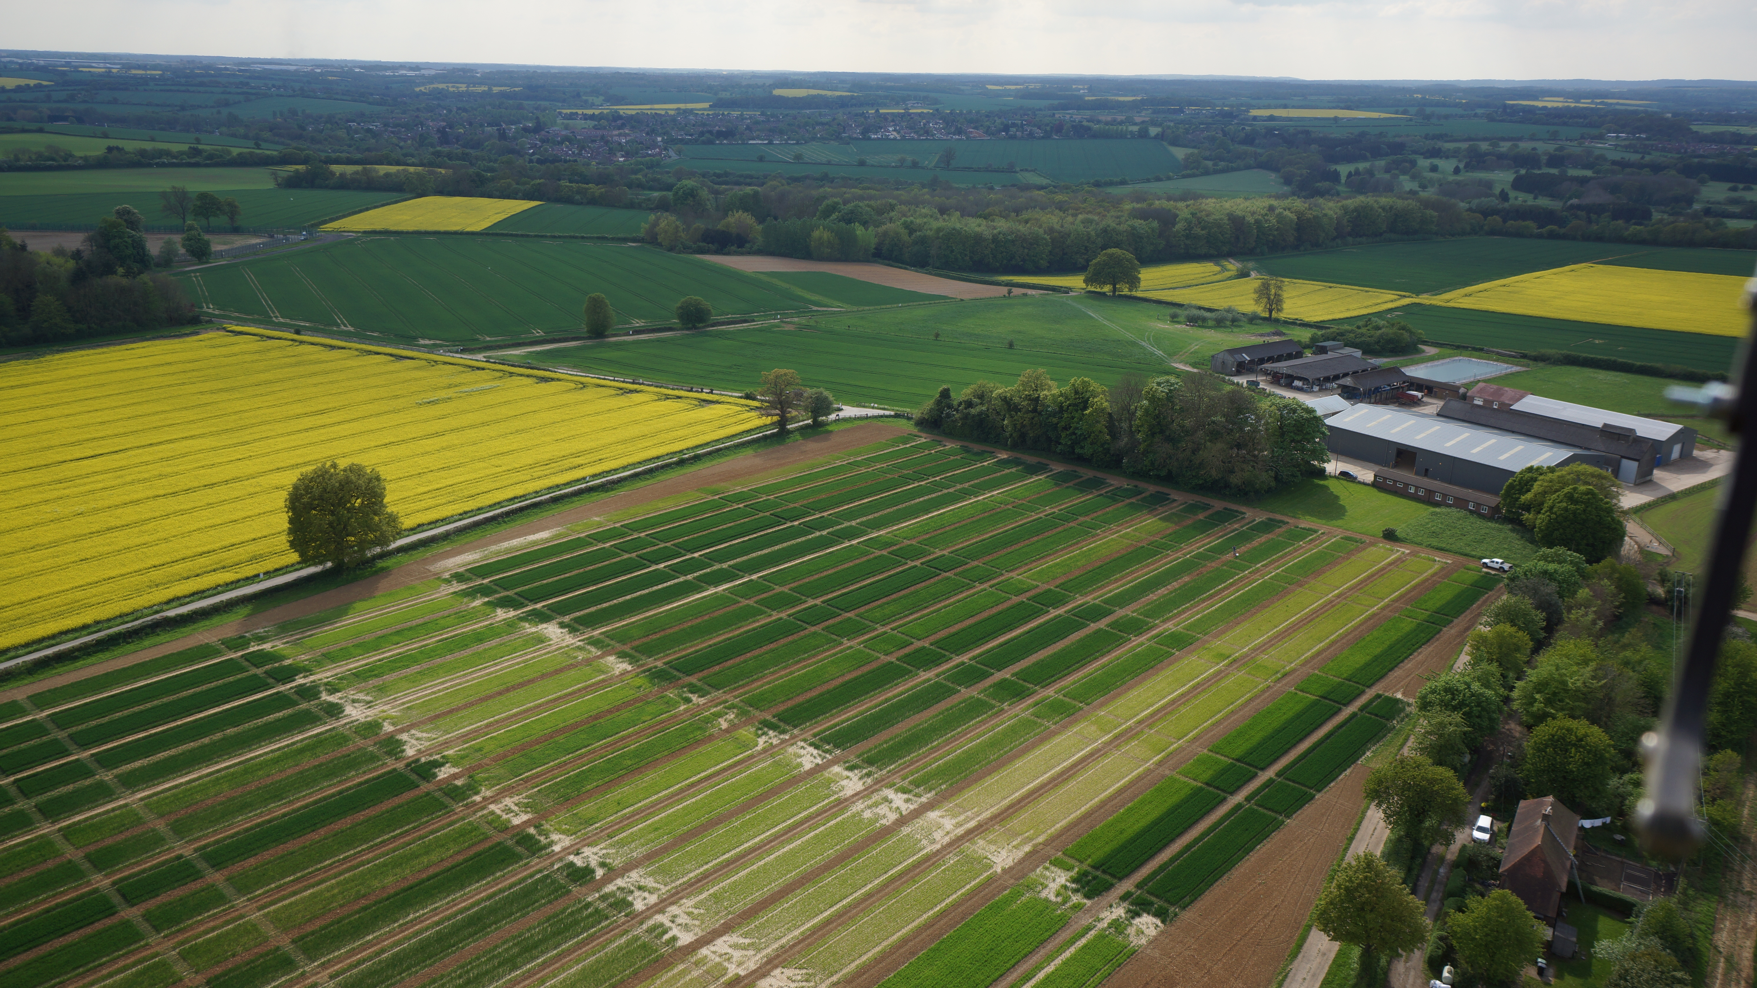
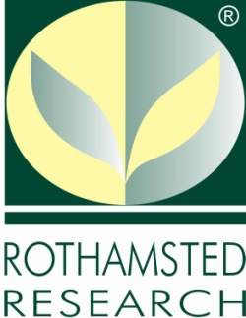


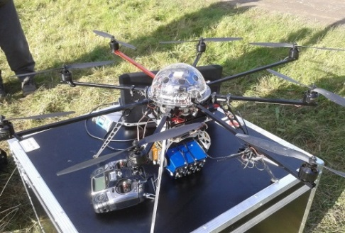
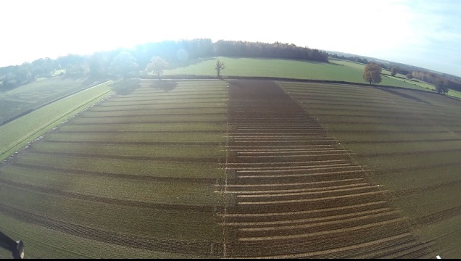
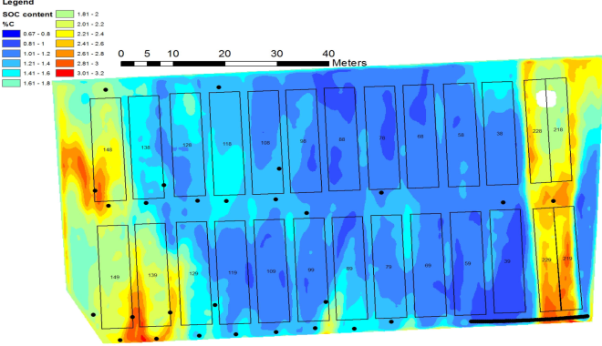
Drones over Broadbalk: Revealing Patterns of Soil Organic Carbon on Broadbalk using Aerial Imaging
Andy Macdonald¹, Emilien Aldana-Jague², Kristof Van Oost² and Keith Goulding¹
¹ Sustainable Soils and Grassland Systems Department, Rothamsted Research, Harpenden, Herts. AL5 2JQ
² Université catholique de Louvain, Earth and Life Institute, Louvain-la-Neuve, Belgium.
In recent years, the costs of both Unmanned Aerial Vehicles (UAVs) and multi-spectral cameras have fallen dramatically, opening up the possibility for more widespread use of these tools in precision agriculture. There is already interest in using this remote sensing technology to help assess crop yield potential and identify problems with weeds, pests and diseases, but relatively little has been done to evaluate its potential to quantify important soil parameters.
Soil Organic Carbon (SOC) is related to numerous soil quality indicators, including aggregate stability, water holding capacity and nutrient availability, amongst others. It also represents a major carbon stock in the terrestrial environment and is influenced by land use, management and climate. Consequently, monitoring the impact of changes in land use, management and climate on soil C stocks is of interest to a wide range of stakeholders in the land-based industries, not least farmers and environmentalists.
The Broadbalk Wheat Experiment comprise strips, each about 300m long and 6m wide, given different amounts and combinations of mineral fertilisers (N, P, K, Na & Mg) and Farmyard Manure (FYM) for over 160 years; resulting in SOC contents in adjacent plots, ranging between 0.8% and 3.5%. Consequently, it provides an ideal site for evaluating remote sensing approaches for mapping SOC.
Photo 1. Octocopter and multispectral camera
In spring 2013 images were collected of soil across a range of SOC contents at low altitude on Broadbalk, using a tripod mounted tetracam Mini-MCA6 multi-band camera with wavelengths between 450-1000nm. The spectral data collected were combined with measurements of SOC, done by dry combustion and acid treatment, to calibrate the camera for use in mapping SOC on Broadbalk using images collected in the subsequent autumn with a UAV-platform (Octocopter; Photo 1.) at an altitude of 120m (Photo 2.). The resulting map of SOC contents (Fig 1.) has a resolution of 10cm and an associated error of about the same magnitude as that for routine laboratory analyses (i.e. 0.2%). The map clearly shows the larger SOC concentrations in the northern plots given annual applications of FYM.
N
Fig 1. Broadbalk Soil C map
Photo 2. Aerial images of Broadbalk from the Octocopter
However, SOC concentrations on the southern plots are greater than measured values, probably due to the effects of soil moisture and shadows from adjacent trees. Further work is underway on another of Rothamsted’s long-term experiments with contrasting SOC concentrations (Hoosfield Spring Barley) to see how such problems can be resolved.
This work was supported by funds for Transnational Access from the EU ExpeER project (www.expeeronline.eu). The Rothamsted Long-term Experiments are supported by the UK Biotechnology and Biological Sciences Research Council and the Lawes Agricultural Trust under the National Capabilities programme grant.

